Slide 1

Progress in Support of
Risk Management
Recent NIST activities and publications

Slide 2
National Institute of Standards and Technology
G2 is a small business that is proud to provide contractor support to NIST
  We don’t speak for NIST, but pleased to speak about NIST’s great work
NIST’s mission is to
develop and promote measurement, standards, and technology to enhance productivity, facilitate trade,
and improve the quality of life.
Federal, non-regulatory agency around since 1901
Agency of U.S. Department of Commerce
Forensic Science
Disaster Resilience
Advanced Manufacturing
Healthcare
IT and Cybersecurity
Cyber-physical Systems
Advanced Communications
Notes:
Basic info about NIST; dual role to support federal as well as private sector/industry
Organized by labs; sort of like a college campus; nobel prize winners
Work involves collaborating with private sector, so no regulatory requirements.
CSD – fundamental
ACD – application work
We need to start by looking at the background/driver for the Framework…

Slide 3
Relevant NIST & NCCoE Activities
NIST’s Smart Grid efforts provide strategic planning to modernize and stabilize the national grid.
National Cybersecurity Center of Excellence (NCCoE) - a collaborative hub where industry organizations, government agencies, and academic institutions work together to address pressing cybersecurity issues
  Asset Management
  Identity and Access Management (IdAM)
  Situational Awareness
Notes:
Smart Grid Work
Led by our Engineering Lab
Guidelines for Smart Grid Cybersecurity released in 2014
Tech Transfer and Research into secure interoperability and operation

Slide 4
Audience Poll:
How many here are using the NIST Framework?

Slide 5
Several Relevant Frameworks to Leverage
Cyber-Physical Systems (CPS) Framework
Privacy Engineering Framework
Baldrige Excellence Framework
Framework for Improving Critical Infrastructure Cybersecurity (or the Cybersecurity Framework)
Risk Management Framework
NICE Framework (Workforce)

Slide 6
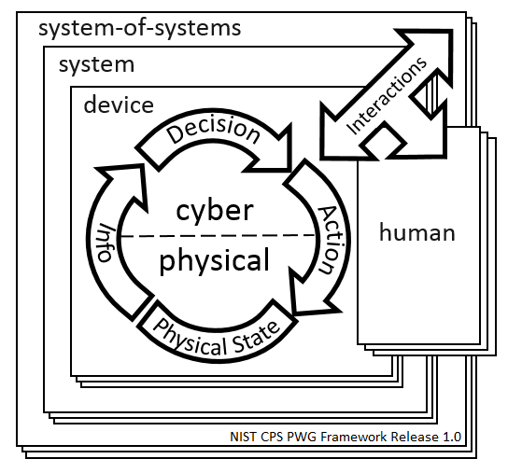
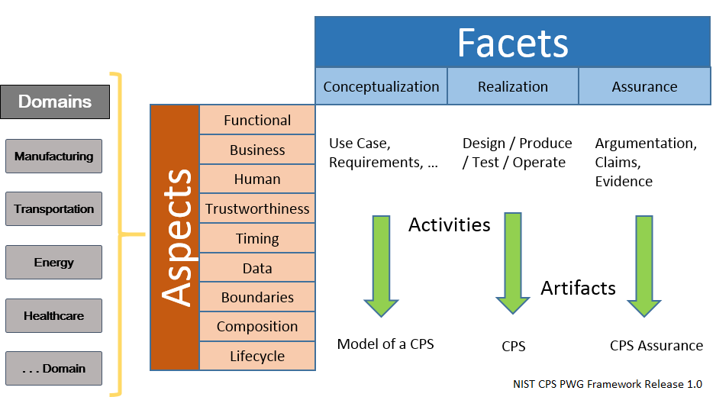
Cyber-Physical Systems Framework
Available from: https://pages.nist.gov/cpspwg/

Slide 7
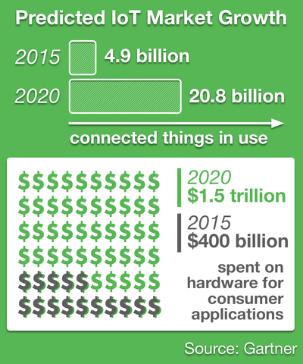
IoT Security and Privacy Risk Considerations
Cybersecurity for Internet of Things Program and the Privacy Engineering Program
  Seeking insights from stakeholders on preliminary ideas for improving security and privacy risk management for IoT
  Considering developing guidance for federal agencies, though much of its content may be useful for other organizations.
  Scoping IoT for guidance to cover the portions where orgs may be at greatest need of information on security and privacy risk management.
  Discussion draft (search for NIST IOT discussion draft)
  Always evolving – see new SP 500-325,
  Fog Computing Conceptual Model

Slide 8
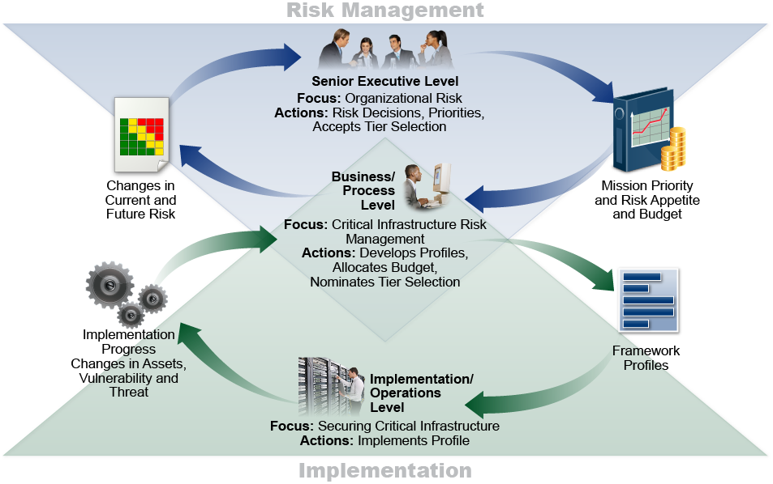
Cybersecurity Framework
Notes:
Supports Cybersecurity Enhancement Act of 2014
It’s flexible to many sectors - Meant to be customized.
Risk-driven system of cybersecurity outcomes – Provides a common language; Does not tell an organization how much cyber risk is tolerable.
It’s meant to be paired - Take advantage of great pre-existing things
It’s a living document - Enable best practices to become standard practices for everyone; updated as technology and threats changes;
Evolves faster than regulation and legislation; updated as stakeholders learn from implementation
Department of Energy&#39;s Energy Sector Cybersecurity Framework
Implementation Guidance(link is external)

Slide 9
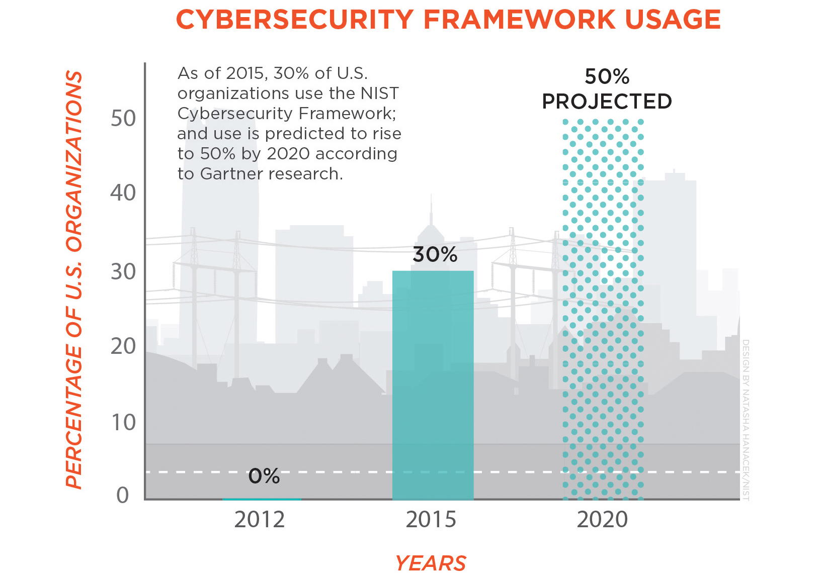
Cybersecurity Framework v1.1
Expected release in April
Clarifies use of Framework Components (i.e., Implementation Tiers and Profiles)
Provides guidance on self assessment metrics and measurements
Adds the concept of identity proofing and expands authorization
Adds Supply Chain Category
Now 23 Categories, and 108 Subcategories
Working on moving Informative References to an online database
Notes:
Updates were based on:
o Feedback from industry,the NIST cybersecurity constituency including responses to our December 2015 request for information, lessons learned from Framework use, shared resources from industry partners, several and an April 2016 Cybersecurity Framework workshops.:
o Advances made in areas identified in the Roadmap the was issued in February 2014, along with the Framework.
Updates FAQs to support understanding and use of Framework.

Slide 10

Self-Regulation
Many recent NIST RFI respondents continued to request that the Framework remain voluntary
Many organizations want to do the right thing but need a
flexible approach
Some of the “old ways” forced prescriptive rules with criteria that didn’t even apply
Notes:
Benefits of the use of frameworks (like COBIT 5 and CSF) for self-regulation, since these support oversight while leaving the implementation details flexible and agile.
Promotes innovation in compliance - seems like an oxymoron - as we often say, understanding risk and managing it well can be a competitive advantage.
It can also be a way for a community, perhaps such as the financial sector, to pool its resources and defend itself.
Look at the recent success through several ISACs - demonstration of how self-regulatory tools and approaches can be coordinated across organizations.
Carrot
Copyright: merrilyanne
Stock photo ID:45793642
Upload date:August 27, 2014
Ruler
Copyright: Stolk
Stock photo ID:46861212
Upload date:September 13, 2014

Slide 11

Self-Regulation
Effective pressure to “do the right thing”
We often hear concerns from organizations that want assurance that they are doing “enough”, both for their own due diligence and also to avoid penalties
Notes:
Ruler
Copyright: Stolk
Stock photo ID:46861212
Upload date:September 13, 2014

Slide 12
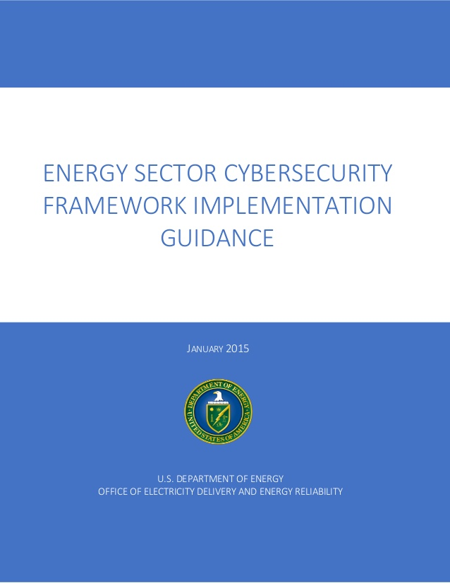
Cybersecurity Framework and Regulation
NIST’s Frameworks complement, don’t compete with most regulatory frameworks
Some models are less prescriptive
Others are quite specific but can align to the higher-level functions and categories

Slide 13

NERC CIP Example: CIP-013-1
High Level outcomes in NIST CSF v1.1
  ID.SC-1: SCRM processes are identified, established, assessed, managed, and agreed to by organizational stakeholders
  ID.SC-2: Identify, prioritize and assess Suppliers/partners
  ID.SC-3: Suppliers/partners required by contract to implement appropriate measures
  ID.SC-4: Suppliers/partners routinely assessed
  ID.SC-5: Response and recovery planning and testing are conducted with suppliers/partners
Introduction
Title: Cyber Security - Supply Chain Risk Management
Number: CIP-013-1
Purpose
Applicability
Requirements and Measures
Compliance
Violation Severity Levels
Regional Variances
Associated Documents
Rationale

Slide 14
A Way of Seeing the Regulatory Environment
Regulator
No surprises on rules or assessments
Reduce engagement backlog
Implementation of new rules by appropriate deadlines
Fulfill government needs and satisfy citizens
Regulated Entity
Clearly understand rules and how to fulfill them
Reduce compliance workload
Quick integration of new rules into cybersecurity operation
Achieve business objectives and gain customers
Clear Communication
Efficient Assessments
Efficient Processing of New Rules
Reduced aggregate risk

Slide 15
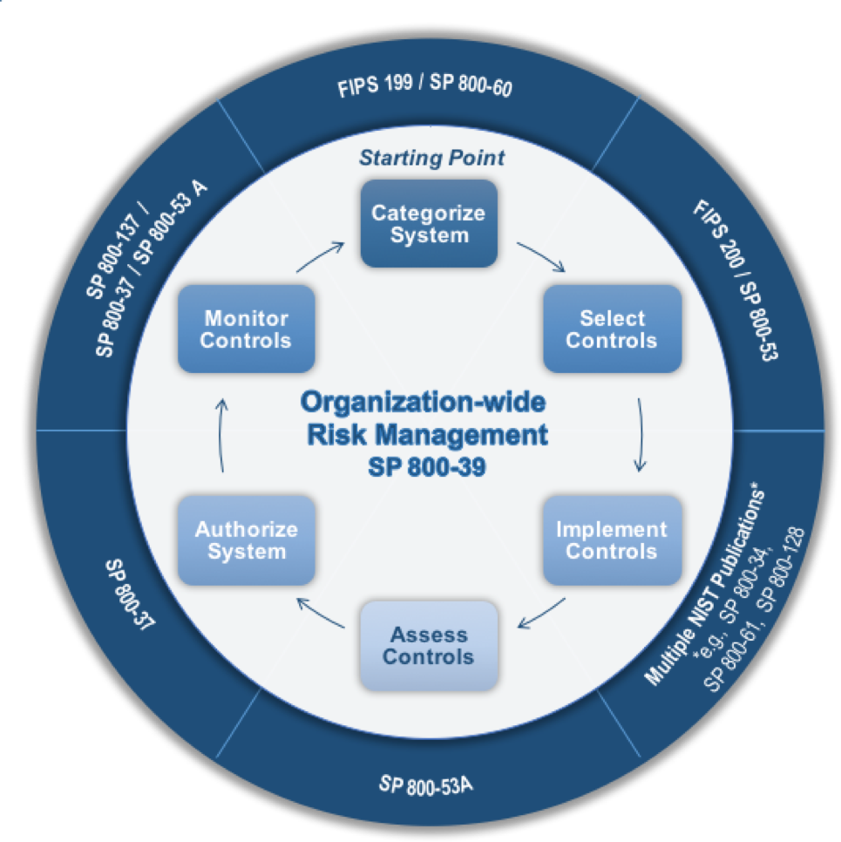
Risk Management Framework
Mandatory for Federal agencies but useful for all
Works in harmony with the
Cybersecurity Framework
Being updated to better support evolving needs, integration with other frameworks, and system engineering approach
  Draft NIST SP 800-160, Vol. 2, Systems Security Engineering: Considerations for Developing Cyber Resilient Systems,
  Cyber resiliency goals, objectives, techniques, approaches, and design principles for system life cycle processes.
Implementation of RMF controls and enhancements contribute to CSF outcomes

Slide 16
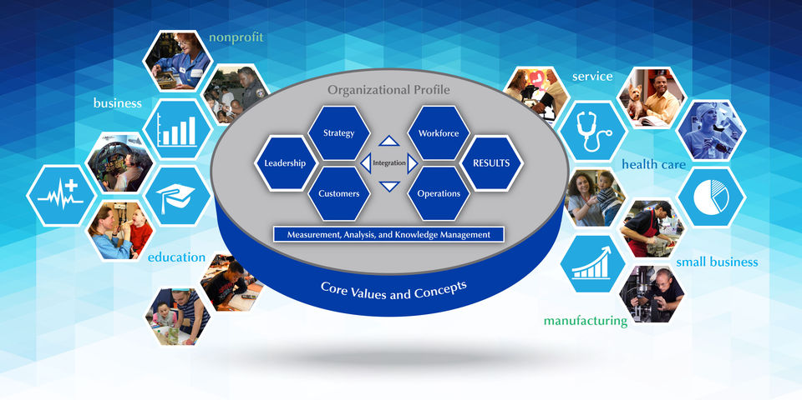
Baldrige Excellence Framework
Cybersecurity Excellence Builder available from:
https://www.nist.gov/baldrige/products-services/baldrige-cybersecurity-initiative
Notes:
A Systems Approach to Improving Your Organization’s Performance
For nearly 30 years, the Baldrige Excellence Framework has empowered organizations to accomplish their missions, improve results, and become more competitive. The Baldrige Excellence Framework includes the Criteria for Performance Excellence, core values and concepts, and guidelines for evaluating your processes and results.
Whether used as guidance in establishing an integrated performance management system or for self-assessing progress, the Baldrige Excellence Framework is about helping you innovate and improve. Available for Business/Nonprofit (including Manufacturing, Service, Small Business, Nonprofit, and Government), Education, and Health Care sectors. Learn about the Impacts of Baldrige.

Slide 17
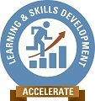

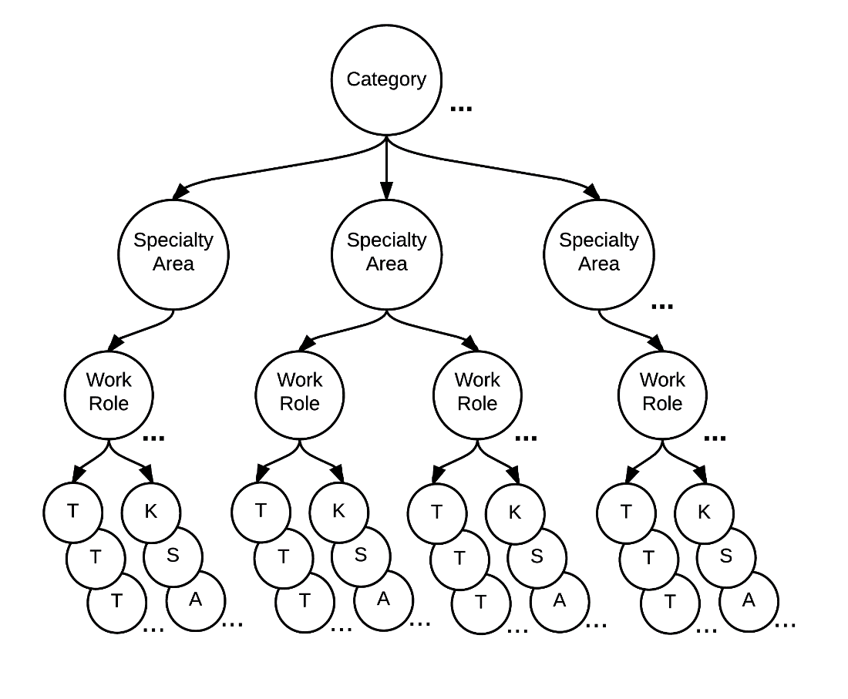

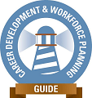
NICE (Cybersecurity Workforce) Framework
Accelerate
Learning and
Skills Development
7 Categories
33 Specialty Areas
Nurture a
Diverse Learning
Community
52 Work Roles
Guide
Career Development
and
Workforce Planning
~1000 Tasks
Knowledge,
Skills,
Abilities

Slide 18
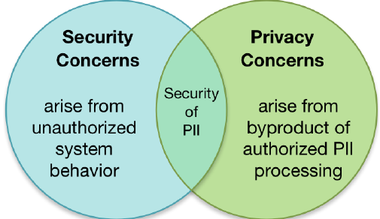
Privacy Engineering
Development of trustworthy information systems by –
  applying measurement science
  system engineering principles
  to the creation of frameworks, risk models, guidance, tools, and standards
  that protect privacy and, by extension, civil liberties.
See: https://www.nist.gov/itl/applied-cybersecurity/privacy-engineering

